Slide 1


IDS BINGO!
https://github.com/MennoMekes/IDS-Bingo

Slide 2




Menno Mekes
Building engineer who loves architecture.
Secretary BIM base IDS expertcommittee.
Material namingconvention Naa.K.T.
ILS voor ruimten in de omgevingswet.
buildingSMART ambassador/jury/SSG.
BIMvoice trainer.
Notes:
Hi, I’m Menno Mekes, just a modeller that loves openBIM and sharing that love.
I’m part of several committees and very active in the Dutch BIM community.
Part of the BIMvoice team and buildingSMART member ofcourse.

Slide 3

11:00-11:15
11:15-12:15
12:15-12:30
Workshop agenda:
Intro
Handing out scorecards, specifications and downloading dataset. QR-code on score-cards.
Tour through the model
Workshop instructions
workshop
Create specifications
Import IDS and Validate IFC models
Keep scores
BINGO!
- We have a winner
Create IDS
Validate IFC
Score the tool

Slide 4
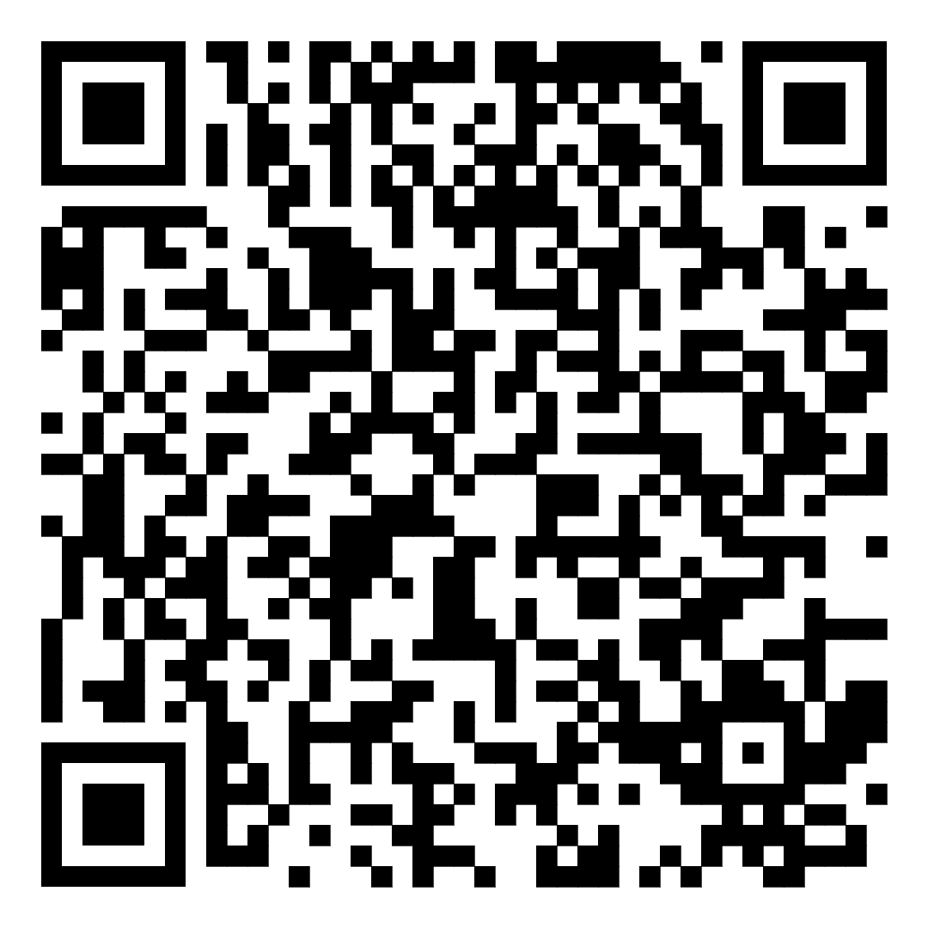
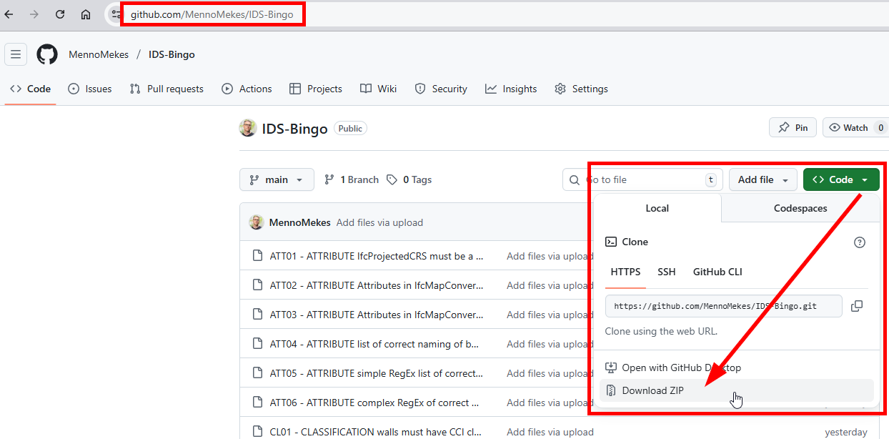
https://github.com/Menno Mekes/IDS-Bingo
Download:
IFC file
IDS files
Instructions
scorecard
Notes:
The QR-code downloads everything
Or you can go to my github and download it yourself.
Go to code > download zip.

Slide 5
IDS-Bingo_Berlin ACCA.ids
1 IDS containing all specifications
IDS-Bingo_Berlin instructions.docx
Every specification as human readable including results.
every specification as a seperate IDS
6 specifications for the attribute facet
3 specifications for the classification facet
3 specifications for the entity facet
3 specifications for the material facet
4 specifications for the partof facet
4 specifications for the property facet
https://github.com/Menno Mekes/IDS-Bingo
Notes:
Here’s what you will download

Slide 6
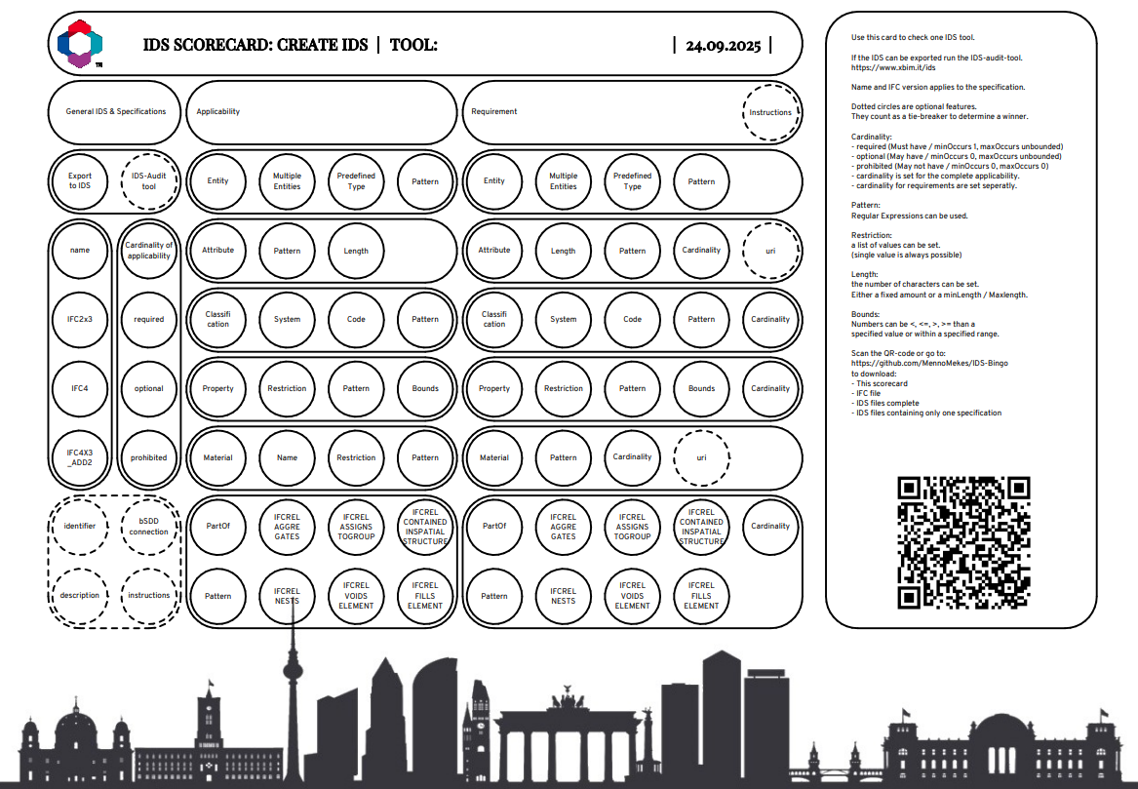
The scorecard (double sided)
https://github.com/Menno Mekes/IDS-Bingo
Notes:
Here’s what you wlil download

Slide 7
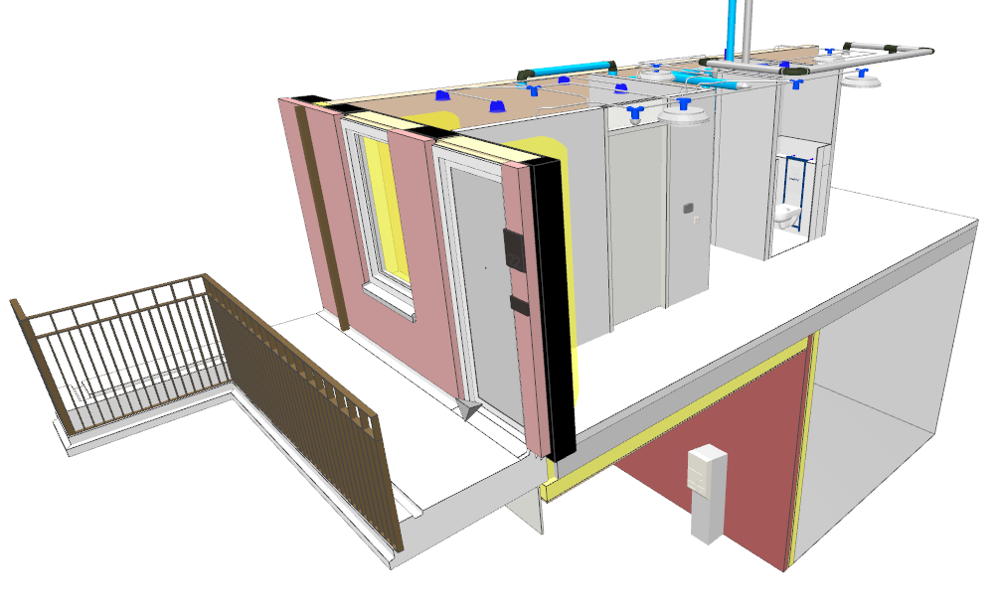
The model
https://github.com/Menno Mekes/IDS-Bingo
Notes:
What about this model?
Its a section of one of our buildings that we used as a proof of concept for the new IDS design and engineering.
So it’s small, it has architectural, structural and MEP elements to showcase the design and engineering as well as the bSDD addin.
And you know, good models are useless so I created mistakes for you to find.

Slide 8

Start the tool of your preference
Choose create or validate and flip the scorecard to that side.
Dabbers at the ready!
Create:
Choose 1 specification per facet to start with.
Start re-creating the specification.
Keep in mind:
Choose another if IFC4x3 is not supported
When bounds don’t work, replace them with =
When patterns don’t work, use single value or a list
Are you an expert? Do another one.
Validate:
Import the big IDS, when it fails, start importing the seperate specifications one by one.
Validate the provided IFC model
Instructions

Slide 9
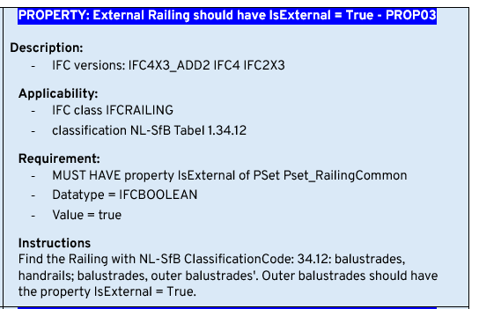
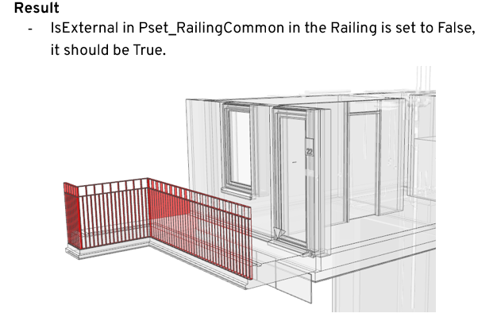
front
back
How does it work?
Notes:
It’s very simple.
Choose a specification and re-create it in your tool
On the back you’ll find the result if you would validate this specification.

Slide 10
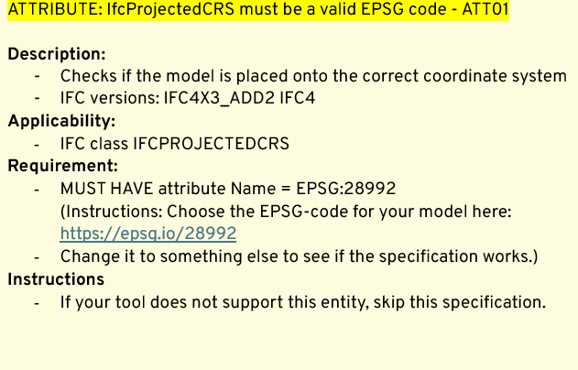
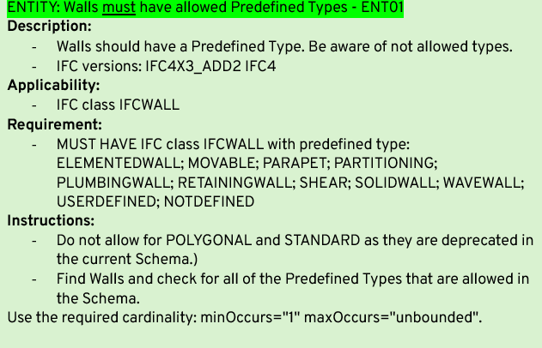
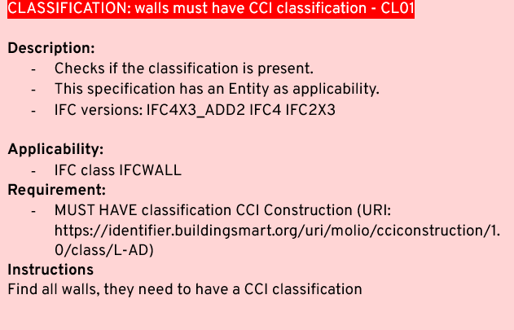
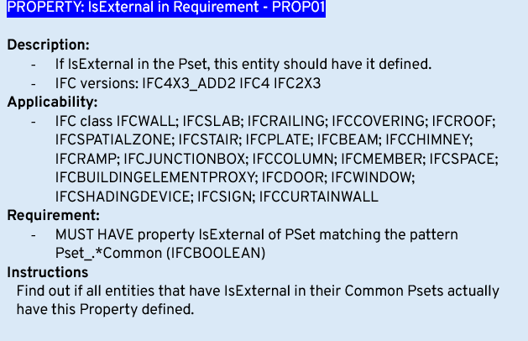
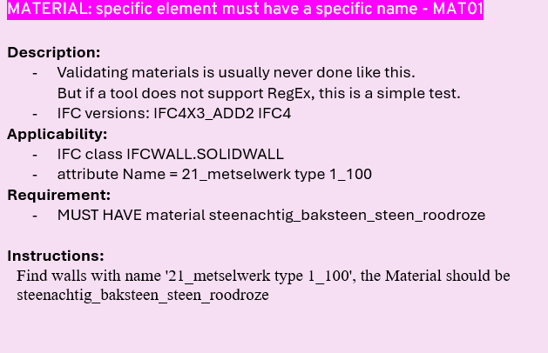
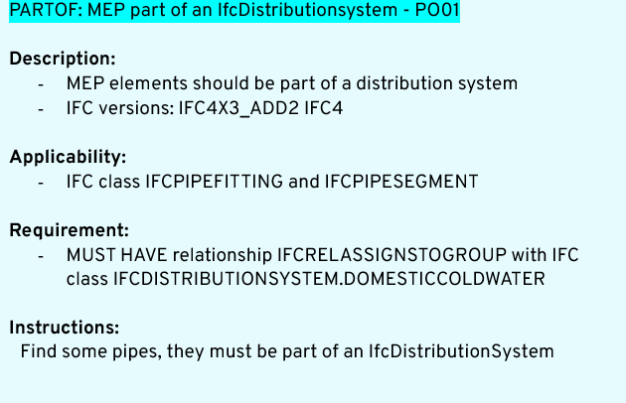
6 facets

Slide 11
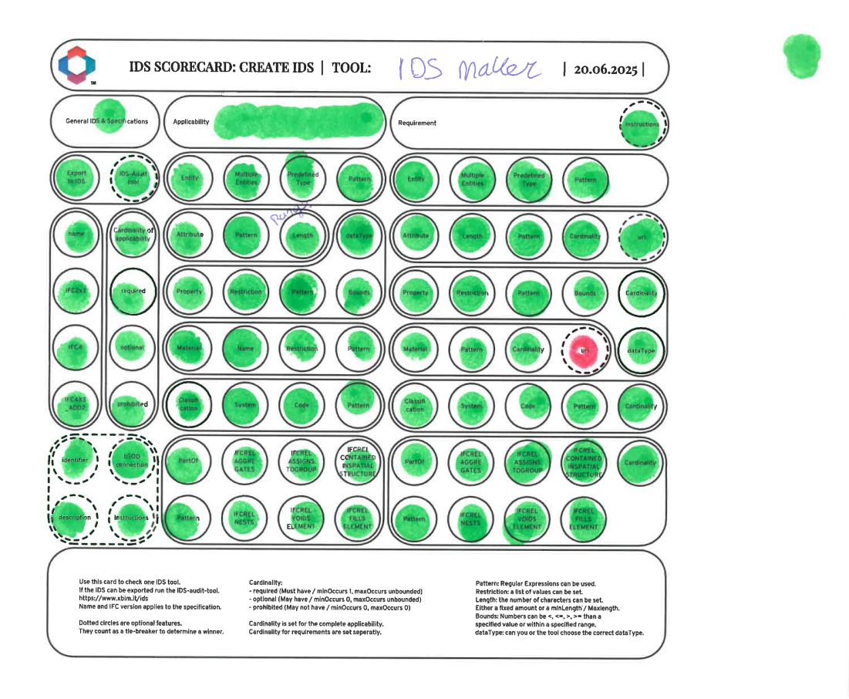
SCORECARD
EXAMPLE
Notes:
Let’s hope we get more of this

Slide 12
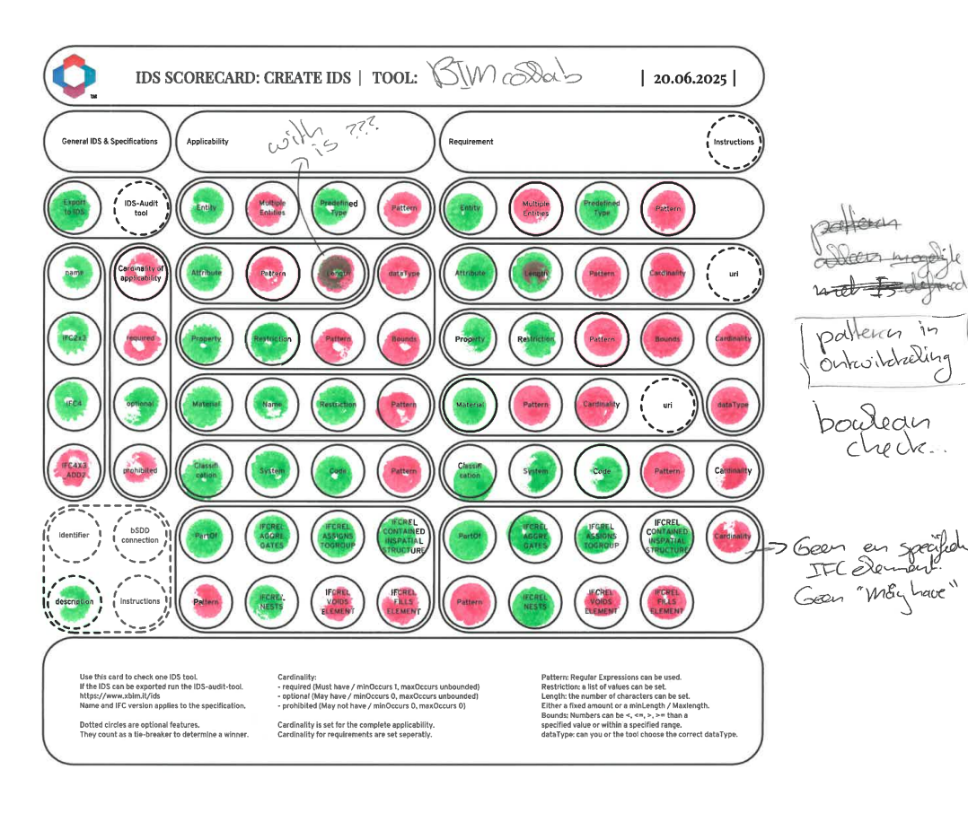
SCORECARD
EXAMPLE
Pattern in development
Notes:
And less of this

Slide 13









SCORECARD
EXAMPLE
Pattern in development
Pattern developed
Notes:
But we’re getting there, this is why I started this.
Vendors listen to us users.

Slide 14

Don’t forget the time
10 minutes per facet
Notes:
So we have an hour more or less. This means 10 minutes per facet.
I will keep track and tell you when it’s time to switch to the next.
When it start to get too loud I assume everybody is ready so I will go ahead

Slide 15

ATT01: IfcProjectedCRS
IFC4, get your model geo-referenced!
ATT02: IfcMapConversion
Eastings is defined
Northings is a specific value
OrthogonalHeight is defined
ATT03: IfcMapConversion
Same as ATT02 but here you check the bounds
ATT04: IfcBuildingStorey
Check the names in a list
ATT05: IfcBuildingStorey
Check the names using a simple RegEx
ATT06: IfcBuildingStorey
Check the names using a complex RegEx
ATTRIBUTE
Regular Expressions are
Not human readable ☹

Slide 16
ENTITY
ENT01: Predefined Types
Must have walls with specific predefined types
ENT02: Predefined Types
May have walls with specific predefined types
ENT03: Predefined Types
Must not have walls with specific predefined types
Prohibited cardinality does not have requirements

Slide 17
CLASSIFICATION
CL01: CCI Classification
Walls must have a CCI classification
CL02: CCI Classification
Concrete walls must have CCI classification L-AD
CL03: CCI Classification
CCI classification L-AD must be a Wall
Create an inverse specification to find more!

Slide 18
Does your tool
support Types?
PROPERTY
PROP01: IsExternal
All entities that can have IsExternal should have it
PROP02: IsExternal
IsExternal in the WallCommon should be a Wall.
PROP03: IsExternal
A railing with a specific classification should be IsExternal = True
PROP04: TicketVendingMachine
Check for several properties, test the bounds

Slide 19
MATERIAL
MAT01: brickwork
A wall named brickwork should have bricks in the materialname
MAT02:
A wall with brickwork in its should have bricks in the materialname
MAT03:
If a material is prefabricated, it should be assembled in a factory
Did you know Naa.K.T. is on the bSDD in English?

Slide 20
PARTOF
PO01: IfcDistributionSystem
All MEP objects should be part of an IfcDistributionSystem
PO02: SmokeSensor
A smokesensor should be in a space
PO03: IfcBuilding
A building must be built on a site
PO04: IfcDoor
A Door should fill an opening in a wall
You are an IfcMember
PartOf buildingSMART!

Slide 21
Interoperability FTW!
PARTY!
BINGO!
Turn in your scorecards.
What tool scored best?

